Slide 1
INFLUENCER FORECASTING IN SOCIAL NETWORK

Slide 2
THE TEAM :
Mentor : Mrs.T.Rajasenbagam M.E , Assistant Professor , Department of CSE.
Members : Dharun A
Mohamed Asik S
Nivas G
Gopinath A
Mohan Raj N

Slide 3
ABSTRACT :
The aim of this project is to predict the influencers in a social network. Here, we can predict the influence rate for an individual person or comparative study of influence rate between the multiple users by using different learning models and auxiliary techniques.In our project , the goal is to predict the influencers in specific social forum such as Twitter.

Slide 4
EXISTING RELATED WORK :
Small World phenomenon :
Approach 1 : Existence of shortest path rate between unrelated people.
Approach 2 : Mean Degree of separation for twitter at 4.59 ( strong inter-linking )
USER GRAPH :
Approach 1 : Vertex Partitioning algorithms.
Approach 2 : Suggesting friends with implicit graphs in twitter

Slide 5
LITERATURE SURVEY

Slide 6
1) BASE PAPER : A Micromodel to Predict Message Propagation for Twitter Users
OBJECTIVE | The goal is to predict the influencers and message propagation in specific social forum such as Twitter.
TECHNIQUES | Decision Tree classification Ego Networks – with follower benchmark & retweet benchmark J4.8 Classifier Random Forest
EXPERIMENTAL RESULTS | J4.8 Classifier accuracy rates Random Forest accuracy rates
ADVANTAGES | Well impact in Sociology , Governance , Economics Will learn the Cognitive properties which make human relations Helpful for Qualitative research to find valid users and to prevent spammers
DE-MERITS | Challenging to predict True Negatives in j4.8

Slide 7
2) The effect of wording on message propagation: Topic- and author-controlled natural experiments on Twitter
OBJECTIVE | To investigate whether a different choice of words affects message propagation, controlling for user and topic.
TECHNIQUES | Crawling time-lines via Twitter API
EXPERIMENTAL RESULTS | Investigates computationally what wording features correspond to messages achieving a broader reach. Use hypothesis testing to evaluate the importance of each feature for message propagation. .
ADVANTAGES | Efficacy and author preference Predicting the “better” wording
DE-MERITS | Propagation prediction becomes more challenging when topic and author controls are applied.

Slide 8
3) The Small World Problem
OBJECTIVE | To determine the shortest paths of acquaintances required to reach each other.
TECHNIQUES | Erdos Number calculation
EXPERIMENTAL RESULTS | Establishes the existence of a short path between unrelated people to deliver a message. Secondly, it showed people collaborating within their independent capabilities could deliver the message outside their immediate social circle.
ADVANTAGES | The empirically-created chains between persons chosen at random form a major population. Establishes a good deal about the integration of society.
DE-MERITS | The big obstacle one runs up against the problem is the social structure.

Slide 9
4 ) Mean Degrees of Separation
OBJECTIVE | To estimate the number of unique friends for each degree of separation
TECHNIQUES | Mean = ln N / ln K ; N = Total Numbers , K = Number of acquaintances
EXPERIMENTAL RESULTS | In our implementation, at each step each person sends a hash value to all his friends. We do this recursively and use math to estimate the number of unique friends for each degree of separation.
ADVANTAGES | Six degrees of separation between user and everyone else on social forum
DE-MERITS | Computing multiple times will produce better results

Slide 10
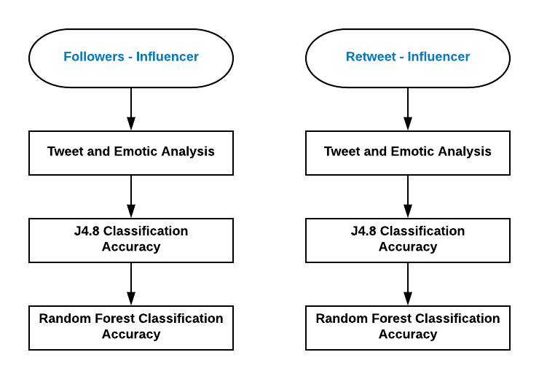
Proposal System

Slide 11
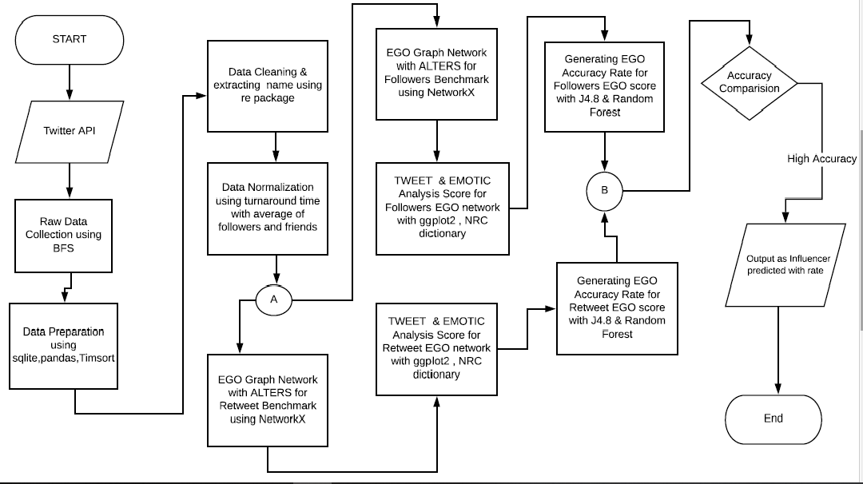
Complete Working Flowchart

Slide 12
Modules
Module 1 : RAW Data Collection
Module 2 : Data Preparation
Module 3 : Data Cleaning and Extracting the user names
Module 4 : Building EGO network Models
Module 5 : EGO Tweet and Emotic analysis
Module 6 : Accuracy Determination of Influencer

Slide 13
Module 1 : Raw Data Collection - Explanation
PLATFORM | PROGRAMMING & Packages | OUTPUT
Anaconda Spyder | Python 3 & tweepy , urlib , csv | CSV Files with 6 Features
Keyword of Extracting Tweets will be Given as Search
Latitude and Longitude of location will be given to find mean degrees of separation.
Calculation of Mean Degree : Mean = ln N / ln K
N = Total twitter population
K = Total location users in population
ln = Natural Logarithm

Slide 14
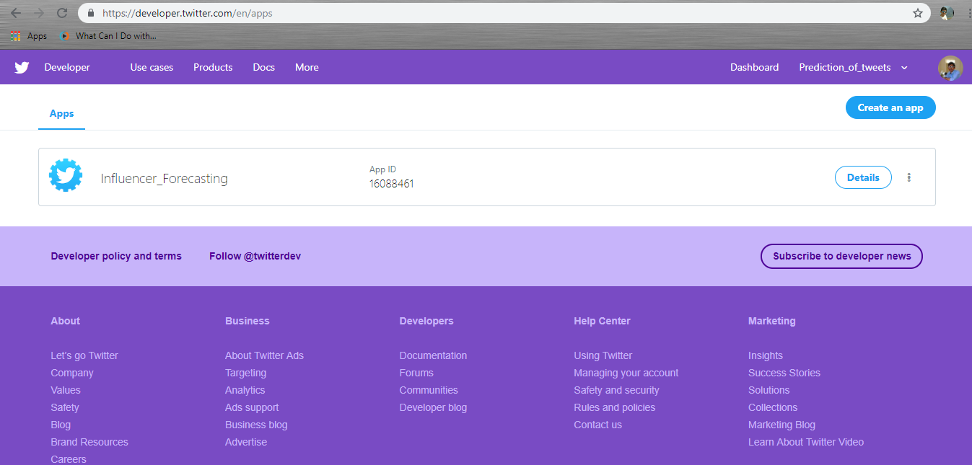
Module 1 : Twitter App – API
Creating Twitter developer App to obtain Authentication Keys

Slide 15
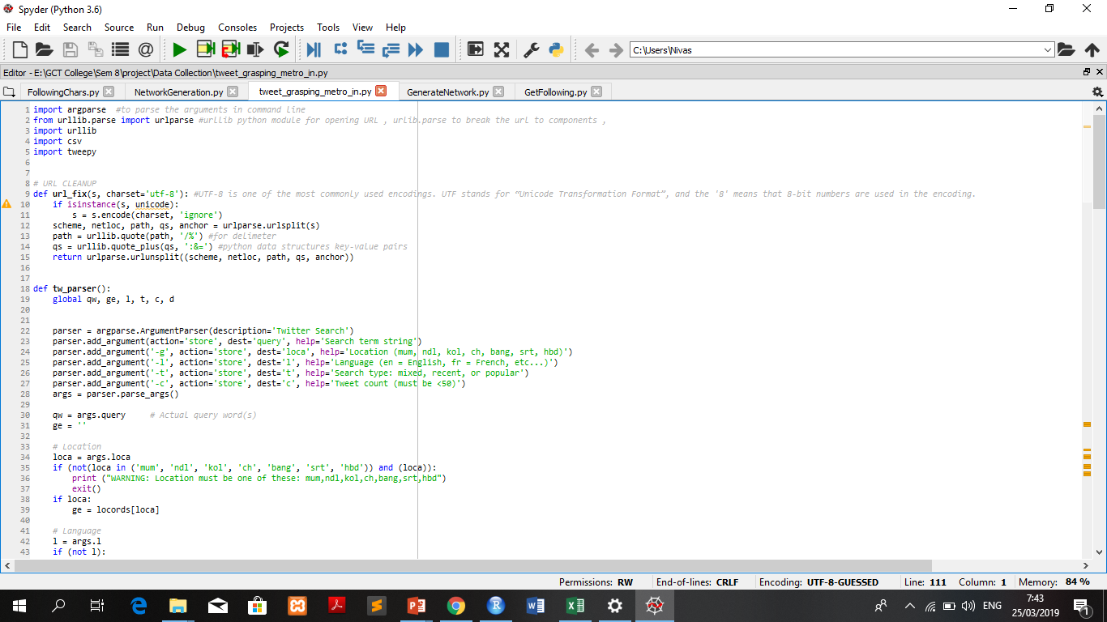
Module 1 : Code Snapshot for Data Collection

Slide 16
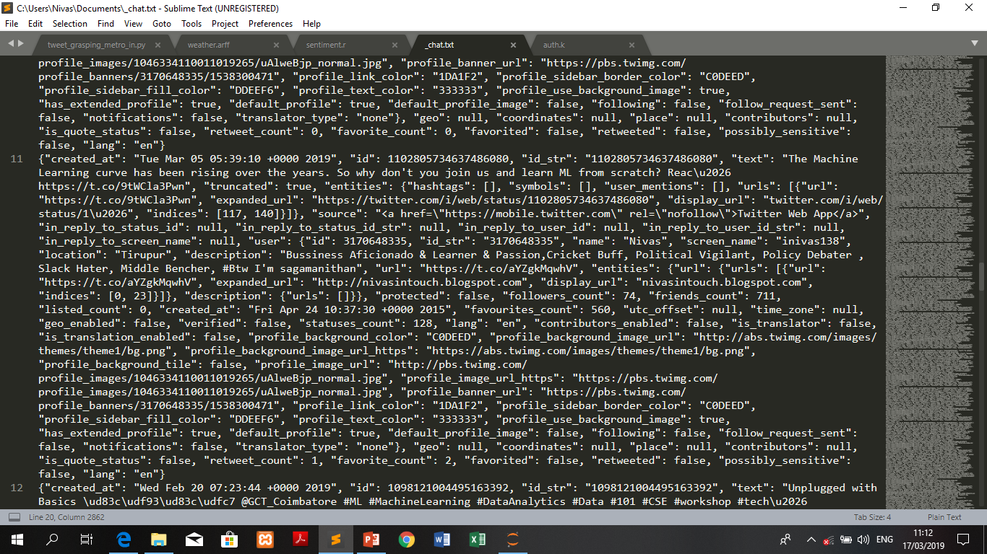
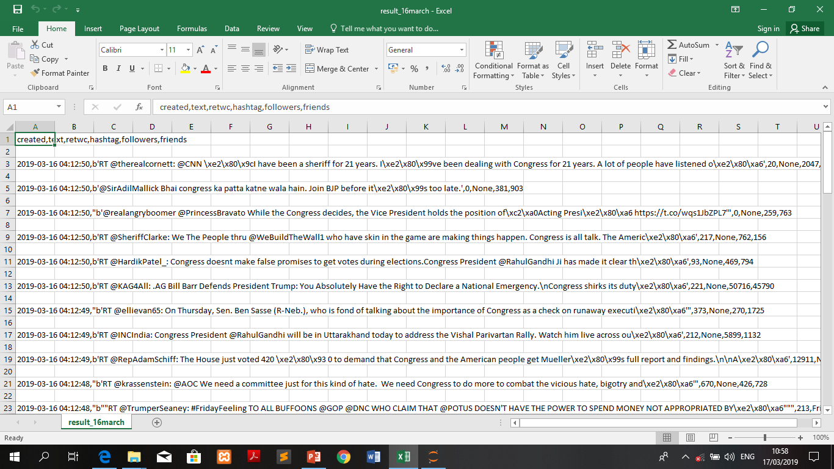
PROGRESSIVE SNAPSHOT : MODULE 1

Slide 17
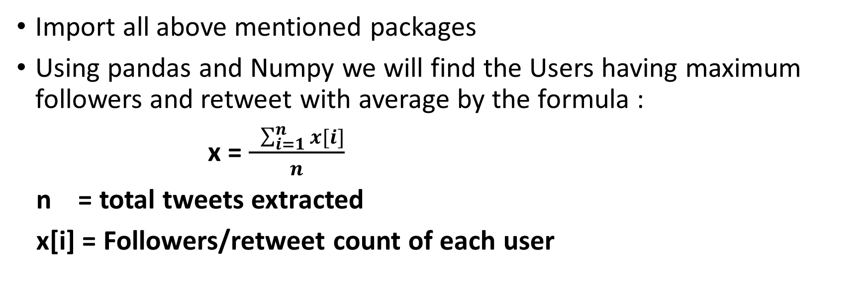
Module 2 : Data Preparation - Explanation
PLATFORM | ALGORITHM | PROGRAMMING & Packages | OUTPUT
Jupyter Notebook | _ | Python 3 & pandas ,tweepy , numpy | Data Frames
Import all above mentioned packages
Using pandas and Numpy we will find the Users having maximum followers and retweet with average by the formula :
x = $\frac{ \sum_{i=1}^{n}{x[i]}}{n}$
n = total tweets extracted
x[i] = Followers/retweet count of each user

Slide 18
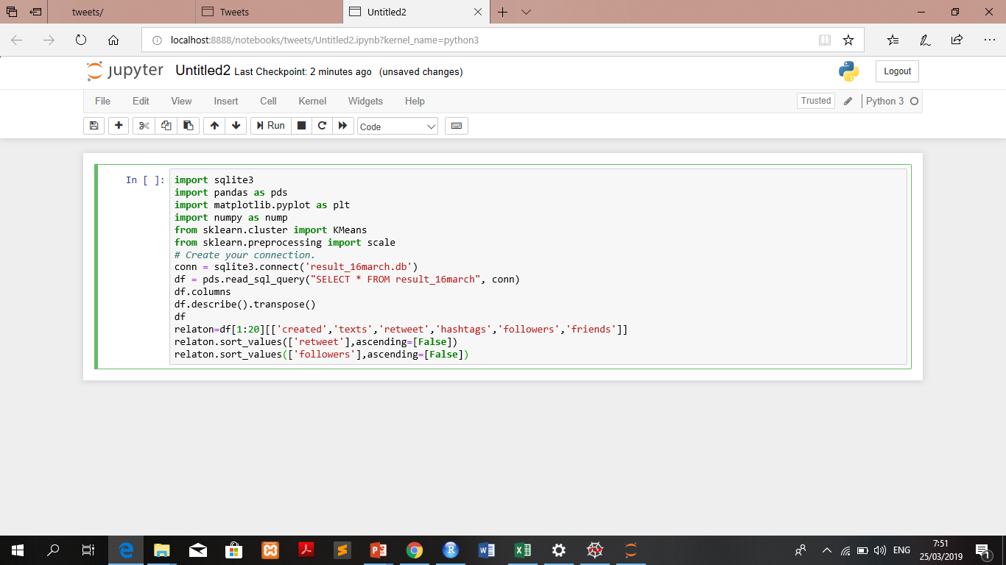
Module 2 : Data Preparation – Coding Snapshot

Slide 19
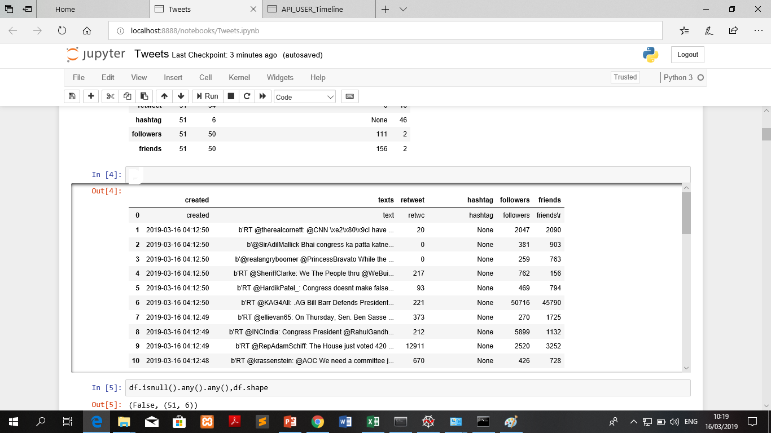
PROGRESSIVE SNAPSHOT : MODULE 2 – DATA FRAME CREATION

Slide 20
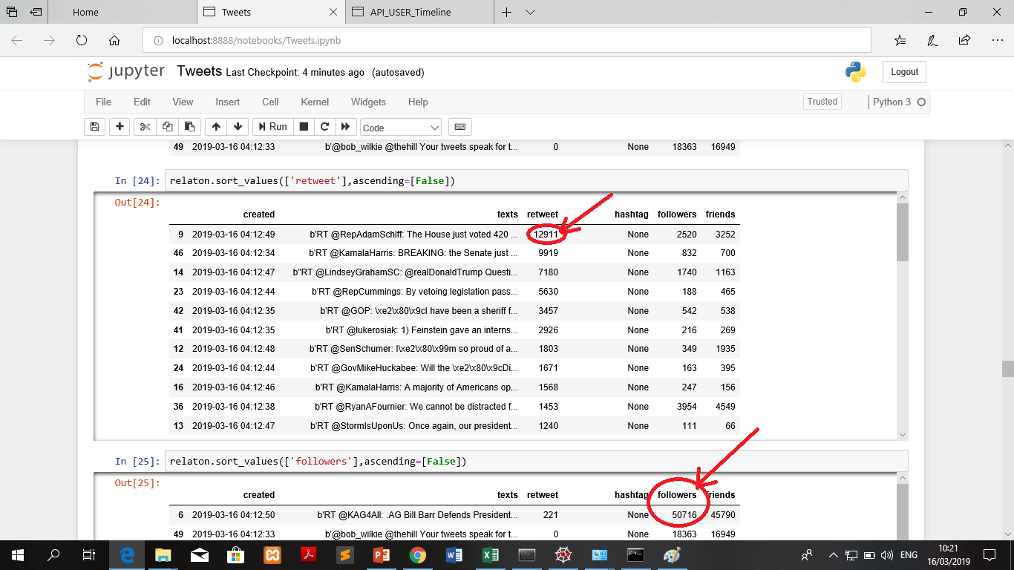
PROGRESSIVE SNAPSHOT : MODULE 2 – MAX RETWEET & MAX FOLLOWERS

Slide 21
Module 3 : Data Cleaning & User name Extraction - Explanation
PLATFORM | PROGRAMMING & Packages | OUTPUT
Jupyter Notebook | Python 3 & numpy , pandas , re ( regular expression ) | User Name Extracted
Import all above mentioned packages
Using pandas we will manipulate the text attribute in data frame.
Manipulation : Cleaning the unwanted parts in a tweet like url-links , stemming's.
Using re package , we will extract the username in tweet

Slide 22
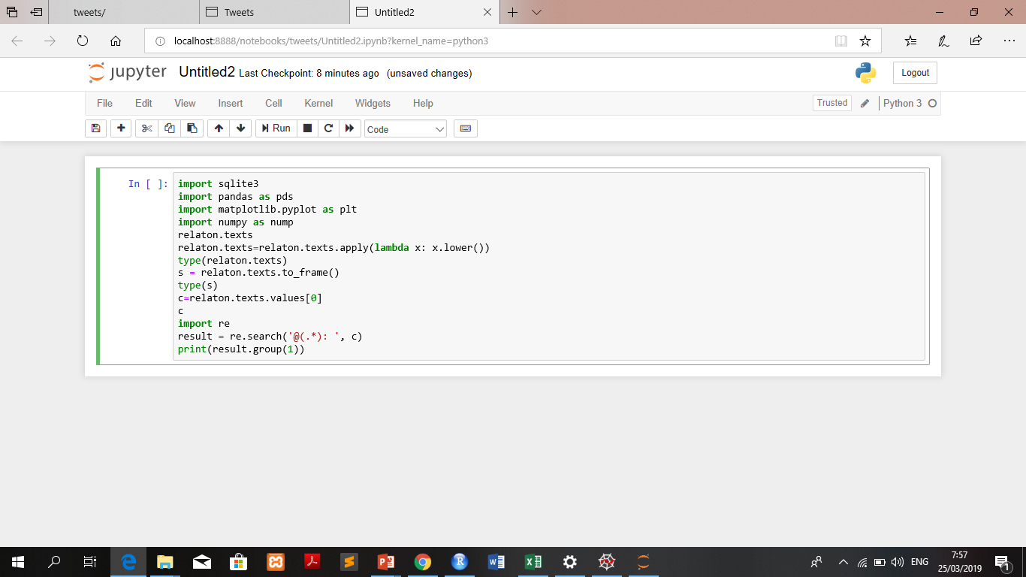
Module 3 : Data Cleaning & Extracting Username
Code Snapshot :

Slide 23
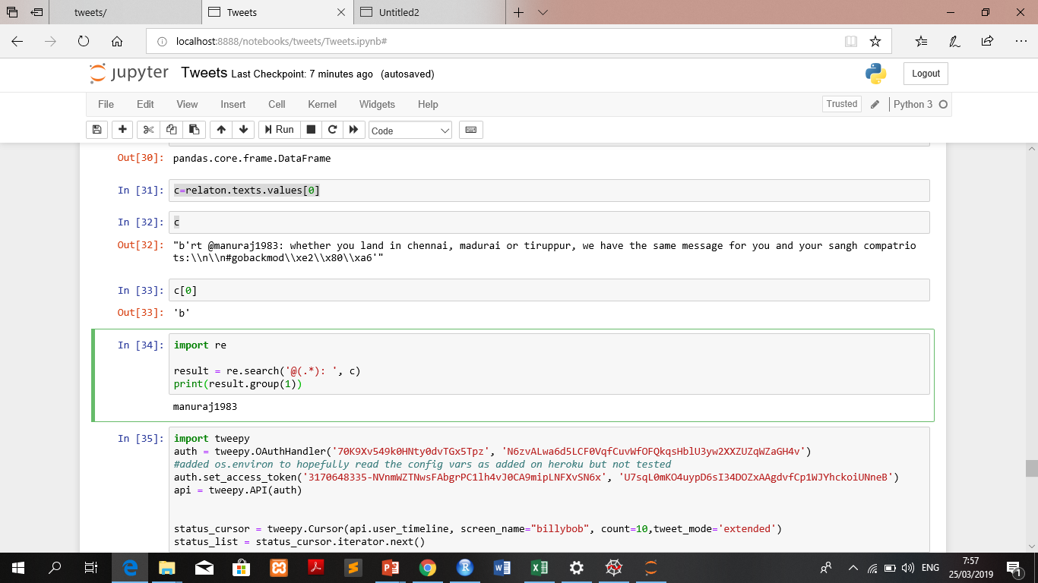
Module 3 : Progressive Snapshot

Slide 24
Module 4 : Building EGO Network Model - Explanation
PLATFORM | PACKAGES | PROGRAMMING | OUTPUT
Jupyter Notebook | Networkx , tweepy ,plotly, Pandas , numpy | Python 3 | EGO Network ( Max Retweet & Max Followers )
Import the above mentioned packages.
With the help of OAuthHandler function , we will grasp all the followers of user ( which extracted in module 3 )
Using numpy convert all the USER ID Type which is float to integer with lambda function manipulation.
Using DiGraph in networkx we will draw an ego network with nodes and edges in a form of spring layout.

Slide 25
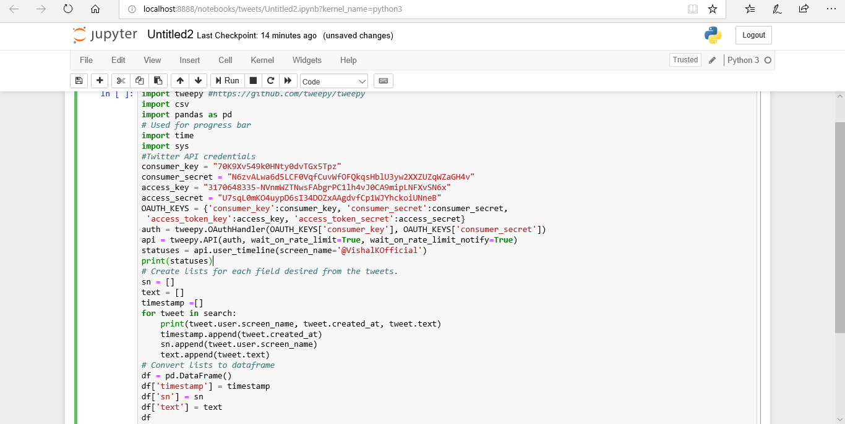
Module 4 : Building EGO Network Model

Slide 26
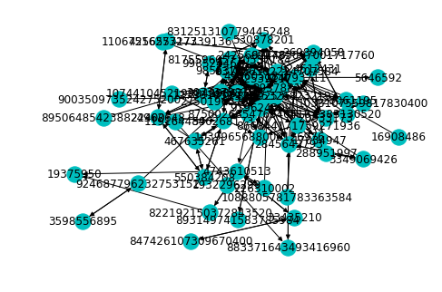
Module 4 : Progressive Snapshot - Maximum Followers Based

Slide 27
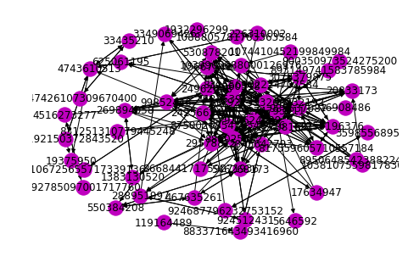
Module 4 : Progressive Snapshot – Maximum Retweet Based

Slide 28
Module 5 : Tweet & Emotic Analysis - Explanation
PLATFORM | PACKAGES | PROGRAMMING | OUTPUT
R Studio | ggplot2 , syuzhet , get_nrc_sentiment | R language | Total ANALYSIS Score ( Max Retweet & Max Followers )
Import the above mentioned packages.
With the help of contentTransformerFunction for removing unwanted symbols in tweet with mapping of text mining
With get_nrc_sentiment will be analysing the total tweet analysis score.
Its done for both retweet influencer and follower influencer

Slide 29
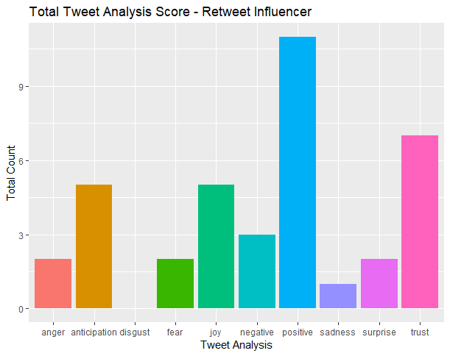
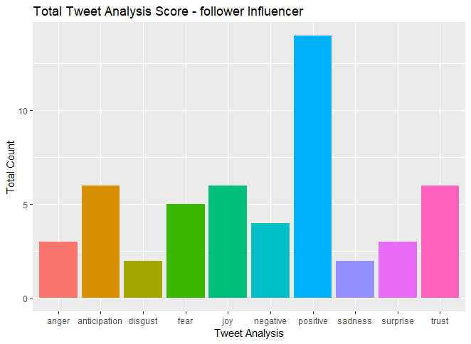
Module 5 : Snapshots

Slide 30
Module 6 : J4.8 Classification - Explanation
PLATFORM | PACKAGES | PROGRAMMING | OUTPUT
R Studio | Rweka , rpart , MASS | R language | Accuracy Percentage
Import the above mentioned packages.
Here will do the two functions such as createDataPartition with 0.7 probability and trainControl function with repeatedcv method respectively.
Accuracy will be displayed based on correctly classified Instances.
Its done for both retweet influencer and follower influencer

Slide 31
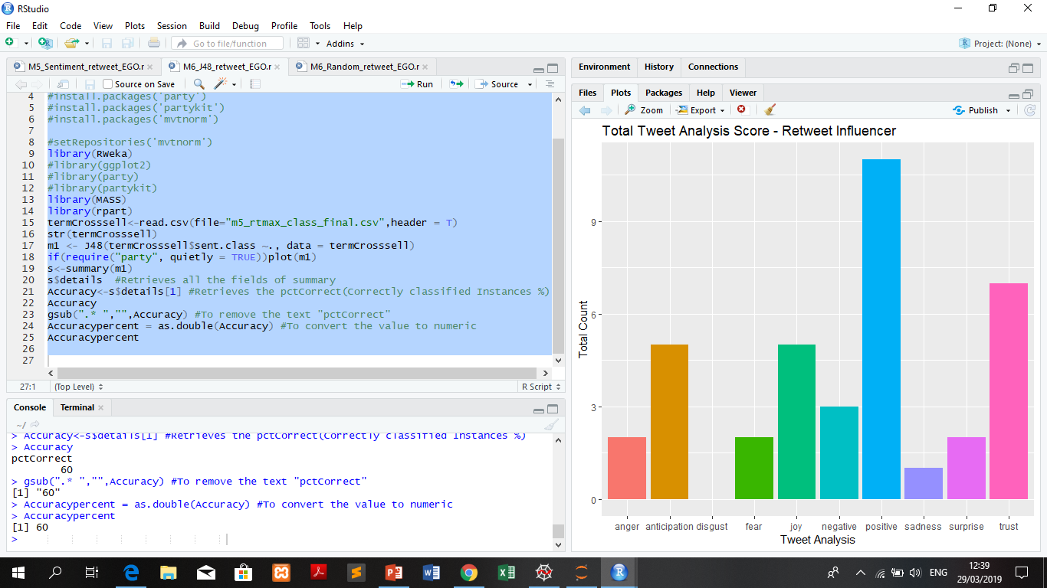
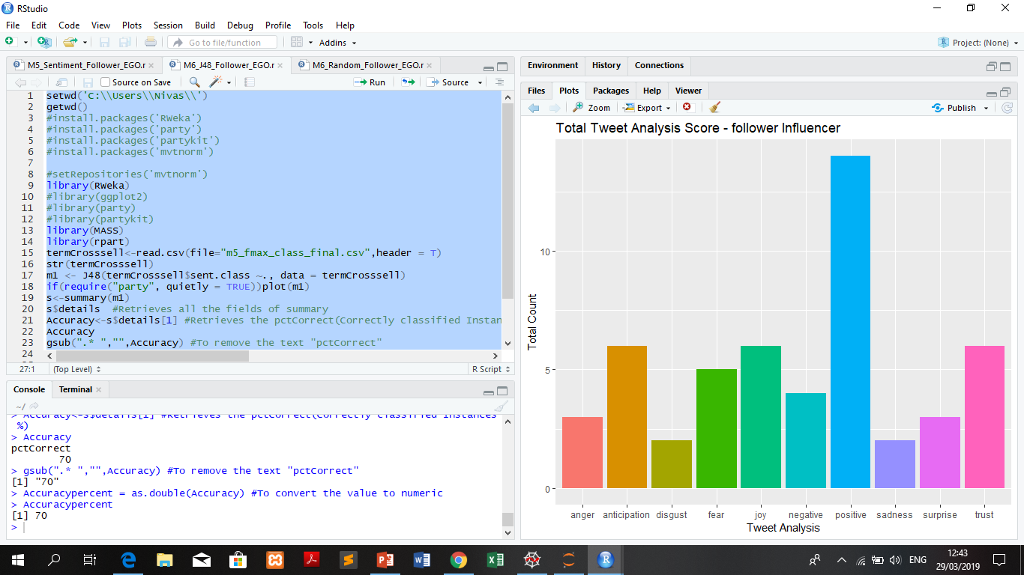
Module 6 : Snapshots – J4.8 Classification Retweet Influencer Follower Influencer

Slide 32
Module 6 : Random Forest Classification - Explanation
PLATFORM | PACKAGES | PROGRAMMING | OUTPUT
R Studio | randomForest , caret | R language | Accuracy percentage CONFUSION MATRX
Import the above mentioned packages.
Here will do the two functions such as createDataPartition with 0.7 probability and trainControl function with repeatedcv method respectively.
Accuracy will be displayed based on correctly classified Instances.
Its done for both retweet influencer and follower influencer

Slide 33
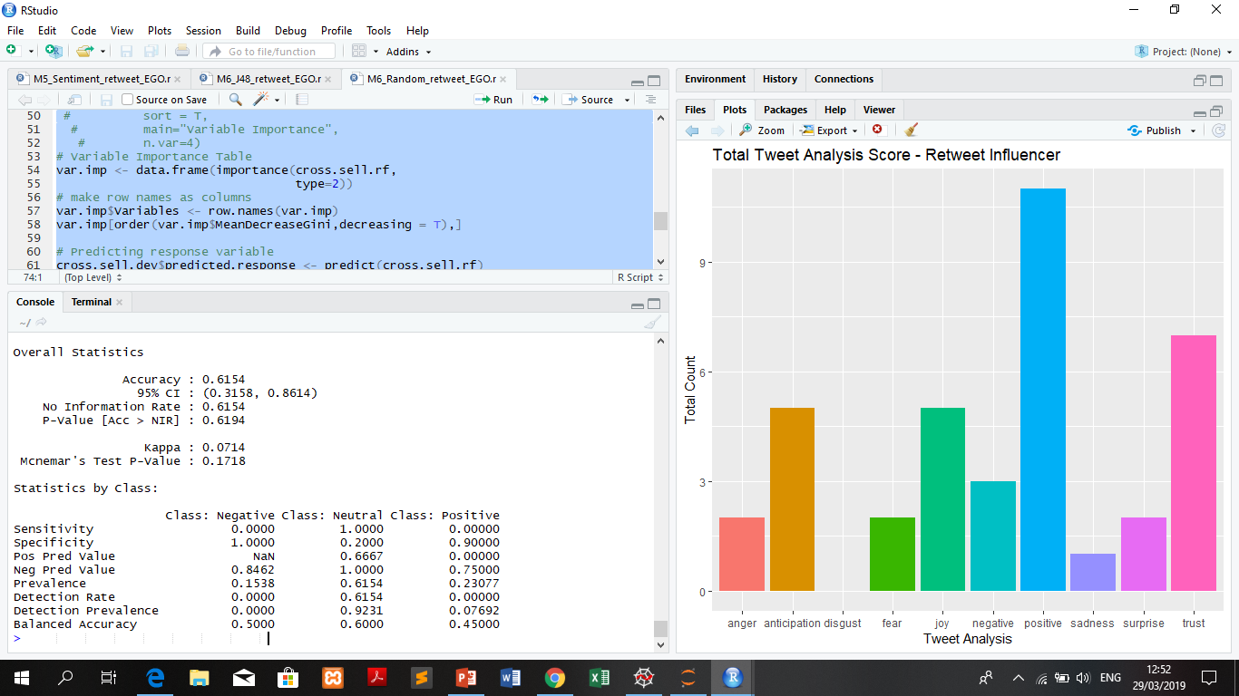
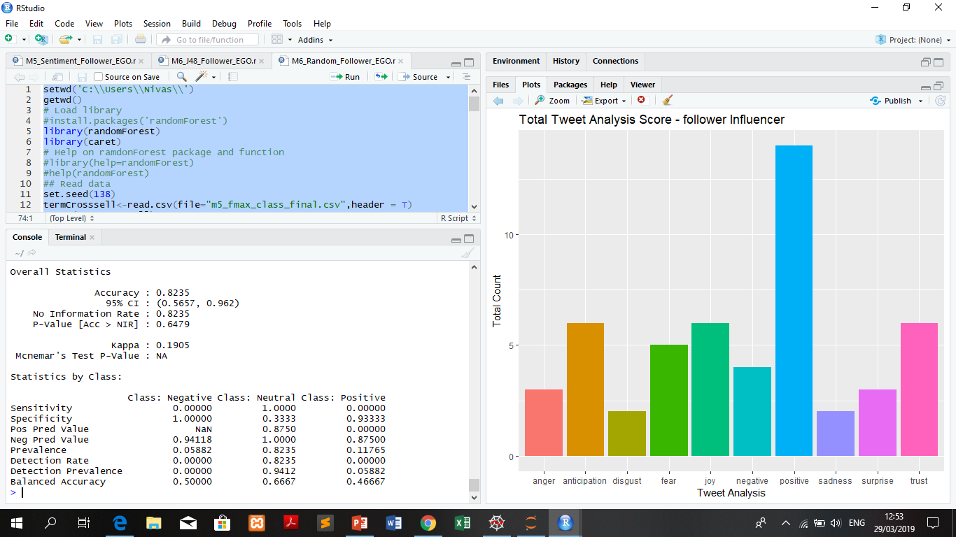
Module 6 : Snapshots – RandomForest Classification Retweet Influencer Follower Influencer

Slide 34
REFERENCES
C.Tan,L.lee,B.pang ,” The effect of wording on message propagation:Topic- and author-controlled natural experiments on Twitter”,ICDSE 2015.
2. J.Travers and S.Milligram , “The Small world, Psychology” Today, Vol no .1, Proceedings of the 32nd Annual ACM Symphosium,2010.
3. G.Vasanthakumar , R.Priyanka , K.V.Raj , S.Bhavani , B.A.Rani , P.D Shenoy , and . K.Venugopal , “PTMIB : Profiling top most influential blogger using content based data mining approach “ , in International Conference on Data Science and Engineering ( ICDSE ) , IEEE 2016.
4. S.Bhagat,M.Burke,C.Diuk,I.O.Filiz, and S.Ednov(2016) Three and half degree of separation [online link] : https://research.fb.com/three-and-half-degrees-of-separation/

Slide 35
THANK YOU

